Slide 1
Series
Intro, Arithmetic Series

Slide 2
Agenda
Today you will …
Learn how to write series using sigma notation
Learn a formula for quickly summing arithmetic series
Practice using English to describe math processes and equations

Slide 3
Review: Vocabulary
Sequence
Term
Rule
Arithmetic Sequence
Common Difference

Slide 4
Review: Sequences
$$a=1, 4, 7, 10, 13, 16, 19$$
Sequence
List of numbers
Ordered, duplicates allowed
May be finite or infinite
May not have a rule
May have a recursive rule
May have an explicit rule
Term
A number in a sequence
Has an index (place in sequence)
The first index is 1, not 0!
Write using index for subscript
$a$ is the sequence
$a_{1}$ is the first term
$a_{n}$ is the $n$th term

Slide 5
Series
A series is what you get from summing the terms of a sequence
Example sequence:
Example series:
(Can also be called a summation, but only for sums of finite sequences!)
$$1, 4, 7, 10, 13, 16, 19$$
$$1+4+7+10+13+16+19$$

Slide 6

$Σ$ (Sigma) Summation Notation
A shorter, more convenient way to write a series
The upper bound: index of last term to sum
The sequence of terms to sum (written as a rule)
$$\sum_{i=1}^{3}{(2+3i)}$$
Sigma, the Greek letter for ‘S,’ for “sum”
$$=\left(2+3\left(1\right)\right)+\left(2+3\left(2\right)\right)+\left(2+3\left(3\right)\right)$$
The index of summation
The lower bound: index of first term to sum

Slide 7
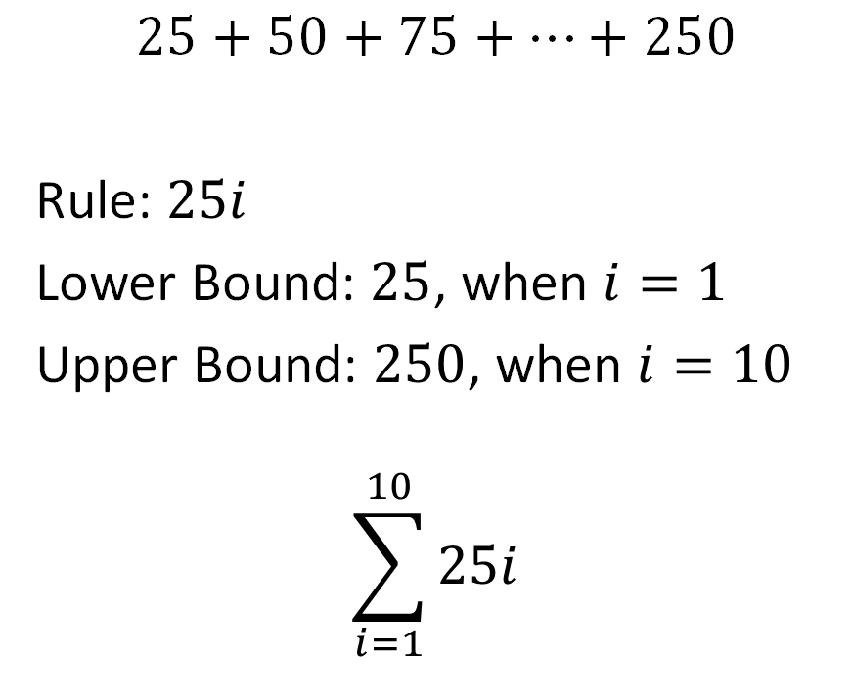
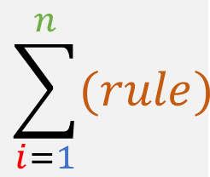
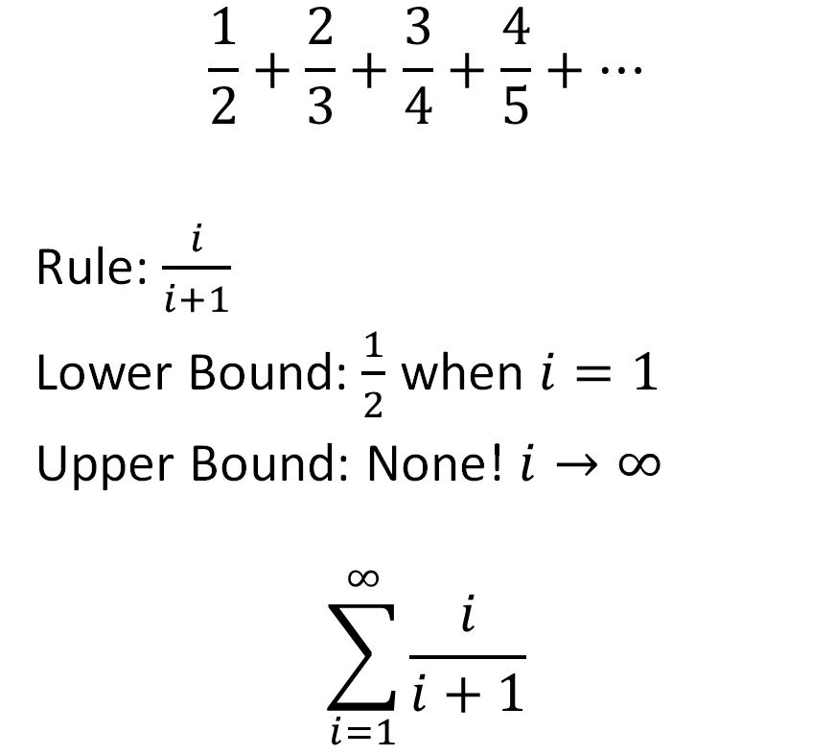
$Σ$ (Sigma) Notation (Practice)
$$\sum_{i=1}^{n}{(rule)}$$
$$\frac{1}{2}+\frac{2}{3}+\frac{3}{4}+\frac{4}{5}+…$$
Rule: $\frac{i}{i+1}$
Lower Bound: $\frac{1}{2}$ when $i=1$
Upper Bound: None! $i→∞$
$$\sum_{i=1}^{∞}{\frac{i}{i+1}}$$
$$25+50+75+…+250$$
Rule: $25i$
Lower Bound: $25$, when $i=1$
Upper Bound: $250$, when $i=10$
$$\sum_{i=1}^{10}{25i}$$

Slide 8
Arithmetic Series
A series which sums terms of an arithmetic sequence

Slide 9

Evaluating Arithmetic Series (Practice)
$$\sum_{i=1}^{4}{−3i+2}$$
$$\left(−3\left(1\right)+2\right)+ \\ \left(−3\left(2\right)+2\right)+ \\ \left(−3\left(3\right)+2\right)+ \\ \left(−3\left(4\right)+2\right)$$
$$\left(−1\right)+\left(−4\right)+\left(−7\right)+\left(−10\right)=−22$$
$$\sum_{i=1}^{40}{−3i+2}$$
$$\left(−3\left(1\right)+2\right)+ \\ \left(−3\left(2\right)+2\right)+ \\ \left(−3\left(3\right)+2\right)+ \\ \left(−3\left(4\right)+2\right)+$$
… oh no
There must be a better way!

Slide 10
Finding a Shortcut
$$1+4+7+10+13+16+19+22$$
$$23+23+23+23$$
And every term is $a_{1}+a_{n}$
Now I have $\frac{n}{2}$ terms
So the sum is … $\frac{n}{2}\left(a_{1}+a_{n}\right)$
Notes:
Why does this work? We’re exploiting the common difference which is present in every arithmetic sequence (by definition of an arithmetic sequence). Every time I move one step right in the series, I add "d" (because each term is the previous term plus d). Each time I move one step left, I subtract "d" for the same reason, except this time I'm going backwards. As I work from the outside in, each step includes one step right (starting from the left) and one step left (starting from the right). So one step toward the middle of the sum adds d to one term, but subtracts d from the other term, and so those d's cancel out.
For example, we started by summing the first and last terms, and then we moved one step “inward,” summing the second from first and second from last terms. Well, the second from first term is d “more” than the first term, while the second from last term is d “less” than the last term. So the second sum is equal to (a_1 + d) + (a_n – d), and those extra “d” terms cancel, leaving you with just (a_1 + a_n) again. The next time you step inward, the same thing will happen. Each time, the term to the 'left' grows by d, but the term to the right 'shrinks' by d.
You can repeat this process n/2 times before reaching the middle of the list. That accounts for all terms in the sum.

Slide 11
Formula for Arithmetic Series
The sum of the first $n$ terms of arithmetic series $a$ is …
$$\sum_{i=1}^{n}{a}=\frac{n}{2}\left(a_{1}+a_{n}\right)$$
Only when $a$ is an arithmetic series!

Slide 12
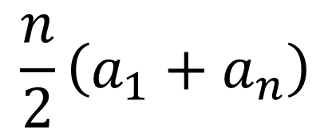

Practice
$$\frac{n}{2}\left(a_{1}+a_{n}\right)$$
$$\sum_{i=1}^{20}{(3i+7)}$$
Find the sum
$n=20$ (… the summation says we’re summing the first 20 terms)
$a_{1}=3\left(1\right)+7=10$
$a_{20}=3\left(20\right)+7=67$
$$\frac{n}{2}\left(a_{1}+a_{n}\right)=\frac{20}{2}\left(10+67\right)=770$$

Slide 13
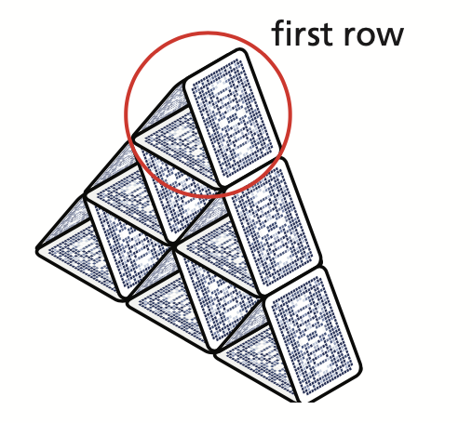

Practice
You are making a house of cards similar to the one shown.
Write a rule for the number of cards in the $n$th row, when the top row is row 1.
How many cards will you need to make a house of cards with 12 rows?
$a_{1}=3$ The top row has 3 cards
$d=3$ Each row has three more cards than the row above it
$$a_{n}=a_{1}+\left(n−1\right)d=3+\left(n−1\right)3=3n$$
$$n=12$$
$$\sum_{i=1}^{12}{3i}=\frac{n}{2}\left(a_{1}+a_{n}\right)=\frac{12}{2}\left(3+3\left(12\right)\right)=6\left(39\right)=234$$
$$a_{1}=3\left(1\right)=3$$
$$a_{n}=3\left(12\right)=36$$

Slide 14
Homework
p423 #24,26,28,48,50,54,56,58,62

